Slide 1

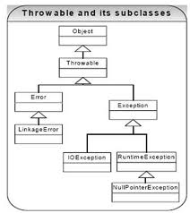
CS/CE 2336 Computer Science II
UT
D
Abstract Classes and Interfaces
Adapted from D. Liang’s “Introduction to Java Programming, 8th Ed.”

Slide 2
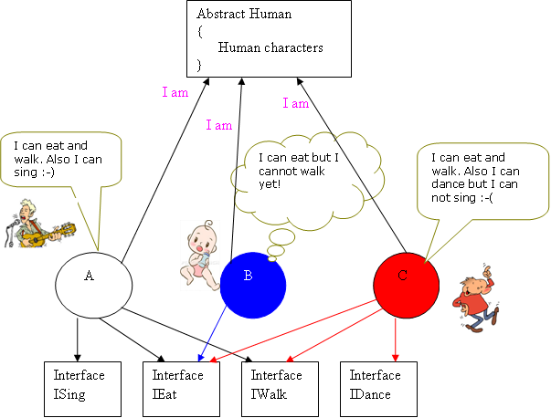
Source: http://www.codeproject.com/KB/architecture/Abstract_Interface.aspx?display=Print

Slide 3
Abstract Class
In superclass subclass hierarchy, as we go up we get more generalized and as we go down we get more specific.
Sometimes a superclass becomes so abstract that it cannot have specific instances.
If implementation of a method depends on a specific object, this method should be declared as abstract.
So, we introduce abstract classes.
An abstract class cannot be used to instantiate objects.

Slide 4
Abstract Class
A class that contains abstract method(s) should be declared as an abstract class.
An abstract class can also contain non-abstract (concrete) methods.
In the abstract class, the abstract methods occur with declaration only – no implementation.
Abstract methods are implemented in the subclass.

Slide 5
Why do we need Abstract Class?
Abstract methods are needed when two or more subclasses are expected to fulfill a similar role in different ways through different implementations
These subclasses extend the same Abstract class and provide different implementations for the abstract methods
Use abstract classes to define broad types of behaviors at the top the class hierarchy, then use its subclasses to provide implementation details of the abstract class.

Slide 6
Abstract Class
public abstract class Creature {
public void breathing(){
System.out.println(“The creature can breath.");
}
public void eating(){
System.out.println(" The creature can eat.");
}
public abstract void walking(); // to be implemented // by a Concrete // subclass.
}

Slide 7
Concrete Subclass
When a concrete class extends the Creature abstract class, it must implement the abstract method walking()
Otherwise, that subclass will also become an abstract class, and therefore cannot be instantiated.
public class HumanBeing extends Creature {
public void walking() {
System.out.println("Human being can walk");
}
}

Slide 8
Abstract Classes and Abstract Methods

Slide 9
Abstract Method in Abstract Class
An abstract method cannot be contained in a non-abstract class
If a subclass of an abstract superclass does not implement all the abstract methods, the subclass must be defined abstract
In other words, in a non-abstract subclass extended from an abstract class, all the abstract methods must be implemented, even if they are not used in the subclass

Slide 10
Object Cannot be Created from Abstract Class!
An abstract class cannot be instantiated using the new operator, but you can still define its constructors!
Why?
Constructors of an abstract class are invoked in the constructors of its subclasses
For instance, the constructors of GeometricObject are invoked in the Circle class and the Rectangle class

Slide 11
Abstract Class without Abstract Method
A class that contains abstract methods must be abstract
However, it is possible to define an abstract class that contains no abstract methods
As with the other case instances of the abstract class cannot be created using the new operator
This class is used as a base class for defining a new subclass

Slide 12
Superclass of a Abstract Class may be Concrete!
A subclass can be abstract even if its superclass is concrete
For example, the Object class is concrete, but its subclasses, such as GeometricObject, may be abstract

Slide 13
Concrete Method can be Overridden to be Abstract!
A subclass can override a method from its superclass to define it abstract
This is rare, but useful when the implementation of the method in the superclass becomes invalid in the subclass
In this case, the subclass must be defined abstract

Slide 14
Abstract Class as Type
You cannot create an instance from an abstract class using the new operator, but an abstract class can be used as a data type
Thus, the following statement is correct:
GeometricObject[] geo = new GeometricObject[10];
What this does?
It creates an array whose then elements are of GeometricObject type

Slide 15


Interfaces
What is an interface?
Why is an interface useful?
How do you define an interface?
How do you use an interface?

Slide 16
What is Interface? Why is Interface useful?
An interface is a class-like construct that contains only constants and abstract methods
In many ways, an interface is similar to an abstract class, but the intent of an interface is to specify common behavior for classes, including unrelated classes, regardless of their locations in the class hierarchy.
E.g. you can specify that the objects are comparable, edible, cloneable using appropriate interfaces

Slide 17
Define an Interface
To distinguish an interface from a class, Java uses the following syntax to define an interface:
public interface InterfaceName {
constant declarations;
abstract method signatures;
}
Example:
public interface Edible {
/** Describe how to eat */
public abstract String howToEat();
}

Slide 18
Why do we use Interfaces?
To reveal an object's programming interface (functionality of the object) without revealing its implementation details
Supporting the idea of encapsulation
The implementation can change without affecting the caller of the interface

Slide 19
Why do we use Interfaces?
To have unrelated classes implement similar methods (behaviors)
One class is not a sub-class of another
E.g. : Class Hotel and class BigInteger They are not related through inheritance, still you want both to implement comparison methods
isGreater(Object x, Object y)
isLess(Object x, Object y)
isEqual(Object x, Object y)
Define Comparison interface which has the three abstract methods above and implement the Comparison interface in both Hotel and BigInteger classes

Slide 20
Why do we use Interfaces?
To realize multiple inheritance
A class can extend only one class, but it can implement multiple interfaces (separated by comma)

Slide 21
Interface is a Special Class
An interface is treated like a special class in Java
Each interface is compiled into a separate bytecode file, just like a regular class
Like an abstract class, one cannot create an instance from an interface using the new operator, but in most cases one can use an interface more or less the same way as an abstract class
For example, one can use an interface as a data type for a variable, as the result of casting, and so on

Slide 22
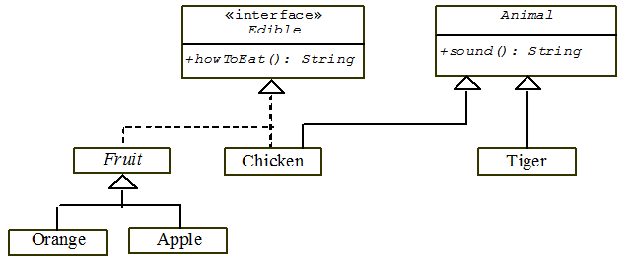
Example
Edible interface specifies whether an object is edible
A class for an object implements this interface using the implements keyword
For example, the classes Chicken and Fruit implement the Edible interface

Slide 23
Omitting Modifiers in Interfaces
All data fields are public final static and all methods are public abstract in an interface
For this reason, these modifiers can be omitted, as shown below:
A constant defined in an interface can be accessed using syntax InterfaceName.CONSTANT_NAME (e.g., T1.K)

Slide 24
Example: The Comparable Interface
// This interface is defined in
// java.lang package
package java.lang;
public interface Comparable {
public int compareTo(Object o);
}

Slide 25
Integer and BigInteger Classes
String and Date Classes
25

Slide 26
Example
1 System.out.println(new Integer(3).compareTo(new Integer(5)));
2 System.out.println("ABC".compareTo("ABE"));
3 java.util.Date date1 = new java.util.Date(2013, 1, 1);
4 java.util.Date date2 = new java.util.Date(2012, 1, 1);
5 System.out.println(date1.compareTo(date2));
26

Slide 27
Interfaces vs. Abstract Classes
In an interface, the data must be constants; an abstract class can have all types of data
Each method in an interface has only a signature without implementation; an abstract class can have concrete methods
 | Variables | Constructors | Methods
Abstract class | No restrictions | Constructors are invoked by subclasses through constructor chaining. An abstract class cannot be instantiated using the new operator. | No restrictions.
Interface | All variables must be public static final | No constructors. An interface cannot be instantiated using the new operator. | All methods must be public abstract instance methods

Slide 28
Shallow vs. Deep Copy
Shallow copy: reference to the same object
Deep copy: reference to two different objects

Slide 29
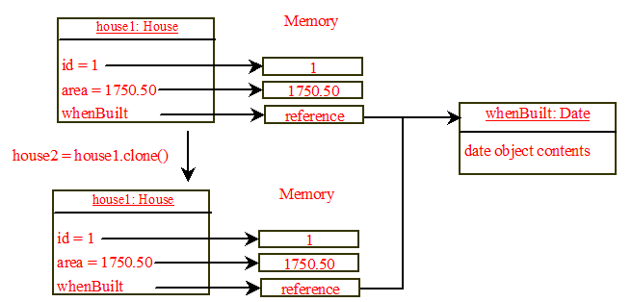
Shallow vs. Deep Copy
House house1 = new House(1, 1750.50);
House house2 = (House)house1.clone();
house1 and house2 are 2 different objects w/ identical contents.
The clone() method copies
the value when the field is primitive data,
the reference of the object, when the field is an object (Shallow copy)
Shallow copy
house1.whenBuilt==house2.whenBuilt True
house1 == house2 False
29
Notes:
29

Slide 30
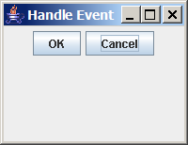
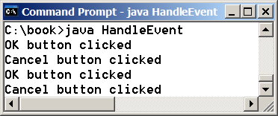
The ActionListener Interface
HandleEvent
Run

Slide 31
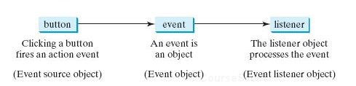
Handling GUI Events
Source object (e.g., button)
Listener object contains a method for processing the event

Slide 32
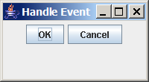
Trace Execution
animation
public class HandleEvent extends JFrame {
public HandleEvent() {
…
OKListenerClass listener1 = new OKListenerClass();
jbtOK.addActionListener(listener1);
…
}
public static void main(String[] args) {
…
}
}
class OKListenerClass implements ActionListener {
public void actionPerformed(ActionEvent e) {
System.out.println("OK button clicked");
}
}
1. Start from the main method to create a window and display it

Slide 33
Trace Execution
animation
public class HandleEvent extends JFrame {
public HandleEvent() {
…
OKListenerClass listener1 = new OKListenerClass();
jbtOK.addActionListener(listener1);
…
}
public static void main(String[] args) {
…
}
}
class OKListenerClass implements ActionListener {
public void actionPerformed(ActionEvent e) {
System.out.println("OK button clicked");
}
}
2. Click OK
ActionListener interface contains actionPerformed() method to process the event.
The listener class must override this method to respond to the event.

Slide 34
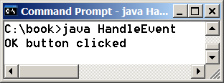
Trace Execution
animation
public class HandleEvent extends JFrame {
public HandleEvent() {
…
OKListenerClass listener1 = new OKListenerClass();
jbtOK.addActionListener(listener1);
…
}
public static void main(String[] args) {
…
}
}
class OKListenerClass implements ActionListener {
public void actionPerformed(ActionEvent e) {
System.out.println("OK button clicked");
}
}
3. Click OK. The JVM invokes the listener’s actionPerformed method

